Slide 1
Liberalization of Abortion Laws and Abortion bans in Latin America: Perspectives on the implications for democracy, social equity, and health
OSCAR A. CABRERA
O’Neill Institute for National and Global Health Law
Georgetown University
cabrera@law.georgetown.edu
Symposium Reproductive Rights in Latin America – Center for Reproductive Rights
June 10, 2014 | Washington, DC

Slide 2
ABOUT THE O’NEILL INSTITUTE
Who are we?
A research institute housed at Georgetown University Law Center (Washington, D.C., USA).
The Role of Law
Law has been, and will remain, a fundamental tool for solving critical health problems in our local, national, and global communities.
We work to encourage key decision-makers in the public, private, and civil society sectors to employ the law as a positive tool to enable individuals and populations throughout the world to lead healthier lives.
Our Integrated Approach:
Combine scholarship, research projects, and capacity building.
7 thematic areas: global health governance; healthcare; health and human rights; infectious diseases; non-communicable diseases; food and drug law; and trade, investment, and health.

Slide 3
STRUCTURE OF THE PRESENTATION
Sexual and Reproductive Health in Latin America
Human Rights: Right to Health and Sexual and Reproductive Health
Progressive Realization - Non-Retrogression
Conclusions
Liberalization of Abortion Laws in Latin America
Oscar Cabrera
O’Neill Institute for National and Global Health Law

Slide 4
1
SEXUAL AND REPRODUCTIVE HEALTH IN LATIN AMERICA
Liberalization of Abortion Laws in Latin America
Oscar Cabrera
O’Neill Institute for National and Global Health Law
www.unidadlatinoamericana.org

Slide 5
UNSAFE ABORTIONS AT THE GLOBAL LEVEL
1
Unsafe abortion is one of the 4 principal causes of maternal death worldwide.
21.6 million women experience an unsafe abortion each year; 18.5 million in developing countries.
13% (47,000/year) result in maternal deaths.
5 million suffer from temporary or permanent disabilities.
20% of deaths and disabilities related to pregnancy and labor.
Almost all cases take place in developing countries where maternal mortality rates are the highest and where access to safe abortion is limited.
Liberalization of Abortion Laws in Latin America
Oscar Cabrera
O’Neill Institute for National and Global Health Law

Slide 6
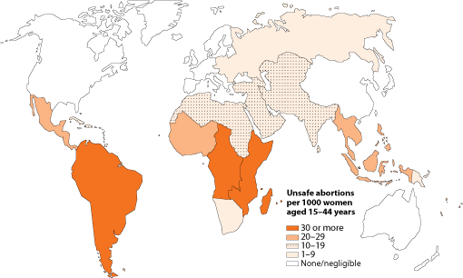
UNSAFE ABORTIONS PER 1000 WOMEN AGED 15-44 YEARS (2008)
1
Liberalization of Abortion Laws in Latin America
Oscar Cabrera
O’Neill Institute for National and Global Health Law
Source: WHO, Unsafe abortion: global and regional estimates of incidence of unsafe abortion and associated mortality in 2008.

Slide 7
SEXUAL AND REPRODUCTIVE RIGHTS IN LATIN AMERICA
1
Liberalization of Abortion Laws in Latin America
Oscar Cabrera
O’Neill Institute for National and Global Health Law
Source: Guttmacher Institute, Abortion Ratios Worldwide in 2008, June 21, 2012, /www.guttmacher.org/media/resources/abortion-ratios.pdf.

Slide 8
WOMEN AT HIGH RISK OF UNSAFE ABORTIONS
1
Women at highest risk of experiencing unsafe abortions:
Low-income
Living in isolated areas
Adolescents, especially unmarried
Living in vulnerable conditions (e.g., refugees)
Why at high risk?
Less access to reproductive health information and services,
More vulnerable to coercion and sexual violence,
More likely to delay seeking an abortion, and
Greater tendency to depend on methods of unsafe abortions and untrained providers.
Liberalization of Abortion Laws in Latin America
Oscar Cabrera
O’Neill Institute for National and Global Health Law

Slide 9
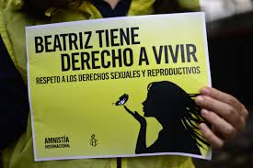
2
HUMAN RIGHTS: RIGHT TO HEALTH AND SEXUAL AND REPRODUCTIVE HEALTH
Liberalization of Abortion Laws in Latin America
Oscar Cabrera
O’Neill Institute for National and Global Health Law
blogs.blouinnews.com

Slide 10
DEFINITION OF “HEALTH”
2
Health is a state of complete physical, mental and social well-being and not merely the absence of disease or infirmity.
--Preamble, WHO Constitution (1948)
Liberalization of Abortion Laws in Latin America
Oscar Cabrera
O’Neill Institute for National and Global Health Law

Slide 11
DEFINITION OF “REPRODUCTIVE HEALTH”
2
Reproductive health is a state of complete physical, mental and social well-being and not merely the absence of disease or infirmity, in all matters relating to the reproductive system and to its functions and processes … Implicit … are the right of men and women to be informed and to have access to safe, effective, affordable and acceptable methods of family planning of their choice, as well as other methods of their choice for regulation of fertility which are not against the law….
--Programme of Action of the International Conference on Population and Development (1994)
Liberalization of Abortion Laws in Latin America
Oscar Cabrera
O’Neill Institute for National and Global Health Law

Slide 12
RELEVANT HUMAN RIGHTS TREATIES
2
Inter-American Convention on the Granting of Political Rights to Women
International Covenant on Economic, Social and Cultural Rights + Protocol
International Covenant on Civil and Political Rights + Protocols
Convention on the Elimination of All Forms of Discrimination Against Women
Convention on the Rights of the Child
Indigenous and Tribal Peoples Convention (ILO No. 169)
American Convention on Human Rights
Convention Belém do Pará
Iberoamerican Convention on the Rights of Youth
Convention against Torture and Other Cruel, Inhuman or Degrading Treatment or Punishment
Liberalization of Abortion Laws in Latin America
Oscar Cabrera
O’Neill Institute for National and Global Health Law

Slide 13
ABORTION AND THE RIGHT TO HEALTH
2
The right to terminate a pregnancy under safe conditions and without risking the health and life of the woman is an element of a woman’s right to health.
ICESCR, Art. 12 (right to health)
State obligations: (a) The provision for the reduction of the stillbirth-rate and of infant mortality and for the healthy development of the child;…(d) The creation of conditions which would assure to all medical service and medical attention in the event of sickness.
CESCR, General Comment 14 on the right to health
The Committee interprets the right to health…as an inclusive right extending not only to timely and appropriate health care but also to the underlying determinants of health, such as …access to health-related education and information, including on sexual and reproductive health. (para. 11).
[A]rt. 12.2 (a) may be understood as requiring measures to improve child and maternal health, sexual and reproductive health services, including access to family planning, .... (para. 14).
Liberalization of Abortion Laws in Latin America
Oscar Cabrera
O’Neill Institute for National and Global Health Law

Slide 14
REPRODUCTIVE RIGHTS AND CEDAW
2
CEDAW, Art. 12 (right to health)
State obligation: [To] take all appropriate measures to eliminate discrimination against women in the field of health care in order to ensure, on a basis of equality of men and women, access to health care services, including those related to family planning.
CEDAW, General Recommendations
[T]he Committee …recommends that: …States parties should …ensure that women are not forced to seek unsafe medical procedures such as illegal abortion because of lack of appropriate services in regard to fertility control…(CEDAW, General Recommendation No. 19, para. 24).
It is discriminatory for a State party to refuse to legally provide for the performance of certain reproductive health services for women. …(CEDAW, General Recommendation No. 24, para. 11).
Liberalization of Abortion Laws in Latin America
Oscar Cabrera
O’Neill Institute for National and Global Health Law

Slide 15
WHY RIGHT TO HEALTH/HEALTH RIGHTS APPROACH
CIVIL AND POLITICAL RIGHTS NOT ENOUGH (JUST A FIRST STEP?)
2
E.g., Autonomy / Self-Determination
Eliminates legal barriers but factual barriers become harder to overcome.
Focus on state not interfering and not on guarantees to access.
Question of whether it helps achieves health equity.
Liberalization of Abortion Laws in Latin America
Oscar Cabrera
O’Neill Institute for National and Global Health Law

Slide 16
WHY RIGHT TO HEALTH/ HEALTH RIGHTS APPROACH?
2
Entitlements to services – Defining States’ Obligations
Coverage
Ensuring access
Potential for reaching vulnerable groups
Liberalization of Abortion Laws in Latin America
Oscar Cabrera
O’Neill Institute for National and Global Health Law

Slide 17
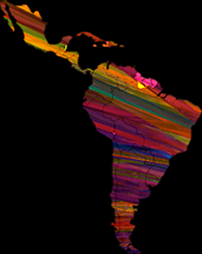
WHY HEALTH RIGHTS APPROACH IN LATIN AMERICA?
1
Status of justiciability of ESCRs
Role of social rights in our constitutions.
Advancing public policies through use of fundamental rights discourse.
Strengthening policies.
Liberalization of Abortion Laws in Latin America
Oscar Cabrera
O’Neill Institute for National and Global Health Law
brlatina.com

Slide 18
PROGRESSIVE REALIZATION -
NON-RETROGRESSION
3
Liberalization of Abortion Laws in Latin America
Oscar Cabrera
O’Neill Institute for National and Global Health Law
siasitv.com

Slide 19
PRINCIPLE OF
“NON-RETROGRESSION”
3
International Covenant on Economic, Social and Cultural Rights
Art. 2.1
Each State Party …undertakes to take steps, individually and through international assistance and co-operation, especially economic and technical, to the maximum of its available resources, with a view to achieving progressively the full realization of the rights recognized in the present Covenant by all appropriate means, including particularly the adoption of legislative measures..
Liberalization of Abortion Laws in Latin America
Oscar Cabrera
O’Neill Institute for National and Global Health Law

Slide 20
PRINCIPLE OF
“NON-RETROGRESSION”
3
American Convention on Human Rights
Art. 26. Progressive Development
The States Parties undertake to adopt measures, both internally and through international cooperation, especially those of an economic and technical nature, with a view to achieving progressively, by legislation or other appropriate means, the full realization of the rights implicit in the economic, social, educational, scientific, and cultural standards set forth in the Charter of the Organization of American States as amended by the Protocol of Buenos Aires.
Liberalization of Abortion Laws in Latin America
Oscar Cabrera
O’Neill Institute for National and Global Health Law

Slide 21
PRINCIPLE OF
“NON-RETROGRESSION”
3
Additional Protocol to the American Convention on Human Rights (Protocol of San Salvador)
Art. 1. Obligation to Adopt Measures
The States Parties …undertake to adopt the necessary measures, both domestically and through international cooperation, especially economic and technical, to the extent allowed by their available resources, and taking into account their degree of development, for the purpose of achieving progressively and pursuant to their internal legislations, the full observance of the rights recognized in this Protocol.
Liberalization of Abortion Laws in Latin America
Oscar Cabrera
O’Neill Institute for National and Global Health Law

Slide 22
“NON-RETROGRESSION” AND NATIONAL CONSTITUTIONS
3
Argentina
Art. 28: The principles, guarantees and rights recognized in the foregoing articles may not be altered by the laws that regulate their exercise.
Chile
Art. 19.26: The security that the legal precepts which, by mandate of the Constitution, regulate or complement the guarantees that it establishes or which limit them in the cases it authorizes, cannot affect the rights in their essence, or impose conditions, taxes or requirements which may impede their free exercise.
Guatemala
Art. 44: The laws and the government provisions or [those of] any other order that reduce, restrict, or distort the rights guaranteed by the Constitution are void ipso jure.
Liberalization of Abortion Laws in Latin America
Oscar Cabrera
O’Neill Institute for National and Global Health Law

Slide 23
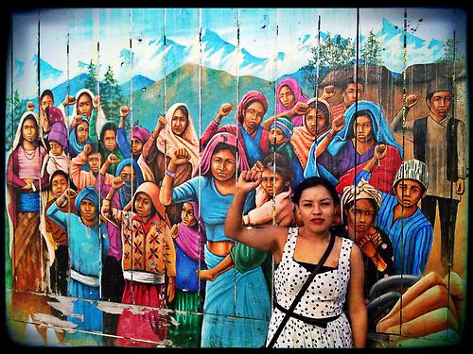
4
CONCLUSIONS
Liberalization of Abortion Laws in Latin America
Oscar Cabrera
O’Neill Institute for National and Global Health Law
artesaniasbetsy.tumblr.com

Slide 24
THANK YOU.
OSCAR A. CABRERA
O’Neill Institute for National and Global Health Law
Georgetown University
cabrera@law.georgetown.edu
Symposium Reproductive Rights in Latin America – Center for Reproductive Rights
June 10, 2014 | Washington, DC

