Slide 1
ABORTION BECAUSE OF THREE REASONS:
CHILE DECIDED
Claudia Dides C. Directora Corporación Miles
Socióloga y Magister en Género, Universidad de Chile
2017
FOR SEX AND REPRODUCTIVE RIGHTS

Slide 2
1. Basic information
Up until 1989: Sanitary Code, article 119, said: “Only because of therapeutic ends a pregnancy could be interrupted, being enough for such a purpose the signature of two surgeon pyshicians”.
September 1989: The Military Junta, six months before leaving power after 17 years of ruling, eliminated Article 119 of the Sanitary Code. It was substituted by the phrase: “No action could be executed whose end were to provoke an abortion”.
Those who because of religious beliefs are opposed to the de-criminalization of abortion should of course be respected. But, on the other hand, no one has the right to impose upon others his/hers beliefs to the whole democratic, free society governed by a Lay State.
This legislation restricted heavily women’s autonomy to decide
Notes:
Constituye un incumplimiento de las obligaciones que el Estado de Chile ha adquirido en materia de derechos humanos de las mujeres.
Convención contra la Tortura y otros tratos o penas crueles, inhumanos o degradantes.
Pacto Internacional de los Derechos Económicos, sociales y culturales.
Convención Belem Do Para.
Convención de los Derechos del Niño.
Comité para la Eliminación de la Discriminación contra la Mujer.
OEA a través del Comitè Expertas del Mecanismo de Seguimiento de la Implementación de la Convención Interamericana para prevenir, sancionar y erradicar la violencia contra la mujer.

Slide 3
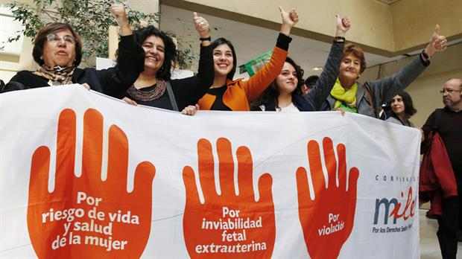
2. Milestones
1990-2010: More than 20 draft laws are presented to Congress by diffrent parliamentarians
2010: Senate Health Commission debates about “the idea to legislate on abortion”. Voting is lost by 2 votes.
2013: New draft law, elaborated by Miles Chile is presented to Congress with the support of 15 Representatives.
2013: Senate supports the Bill
2014: Abortion becomes a debate subject in the presidential election for the first time since 1990
2015: President Michelle Bachelet presents a draft law on “Abortion Because of Three Causes” to Congress (Jan 31st, Boletín N° 9895-11).
2016: Bill is approved by the House of Representatives.
2017, July: Bill is approved by the Senate, but it is a different version than the one approved by the House. Because of this, the bill has to go to a Mixed Commission (House plus Senate)
2017, August: Mixed Commission approves the bill. The opposition (right) announces that it will ask for the intervention of the Constitutional Court because of the “unconstitutional character” of the law
2017, August: Constitutional Court rules against the petition to declare the law on abortion as unconstitutional.
2017, September: Law on “Abortion Because of Three Reasons” is promulgated by President Michelle Bachelet

Slide 4
3. MILES data and arguments to support the Bill
20 Minutes given to decision-makers and parliamentarians with data coming out of national and international studies
Annual Report on Sexual Health, Reproductive Health and Human Rights in Chile
Graphics information with official statistics of the Chilean State

Slide 5
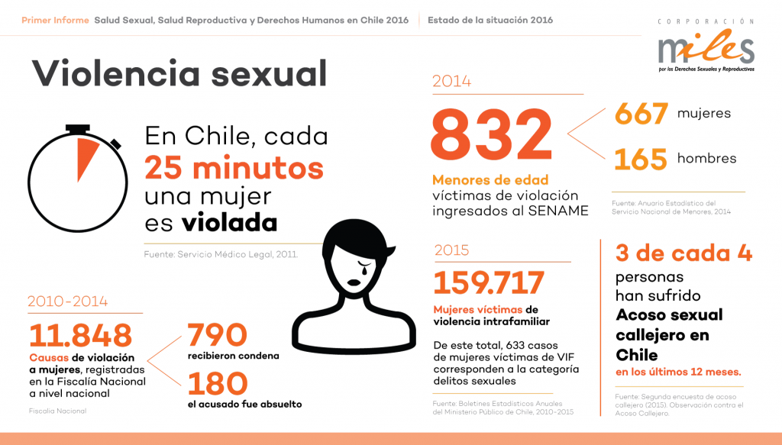

Slide 6
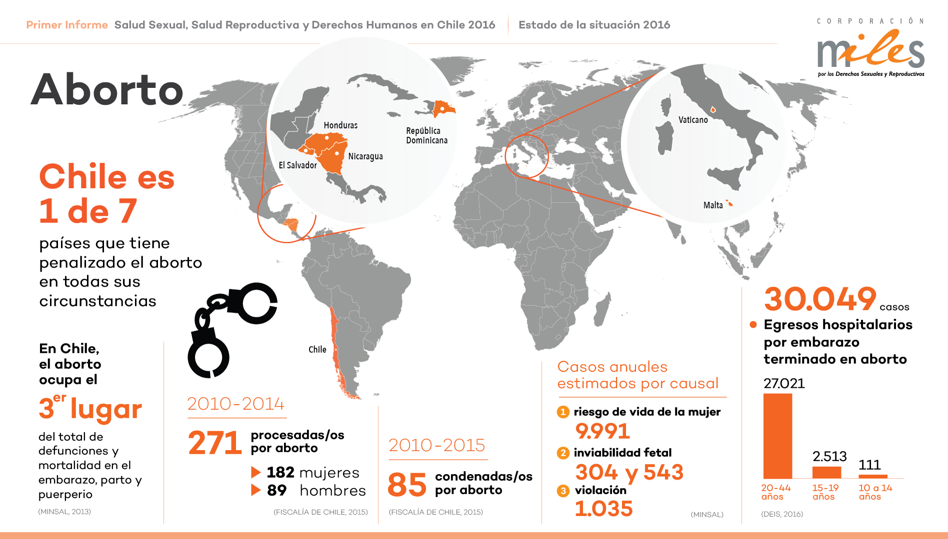

Slide 7
THE MAJORITY ASKS FOR IT (Public Opinion Polls)

Slide 8
Law 21030 IVE Three Causes
1. Woman in vital risk. Abortion avoids a danger for her life.
2. Fetal unviability: Embryo or fetus suffers from a congenital pathology of a lethal character, acquired or genetic, which makes imposible an independent life out of the womb.
3. Pregnancy resulting from a rape: in general pregnancy could be interrupted up to 12 weeks of gestation. In the case of girls younger than 14 years old, interrupotiuoin of pregnancy may be done up to 14 weeks after gestation.
Notes:
Aborto es algo histórico, no es lucha moderna

Slide 9
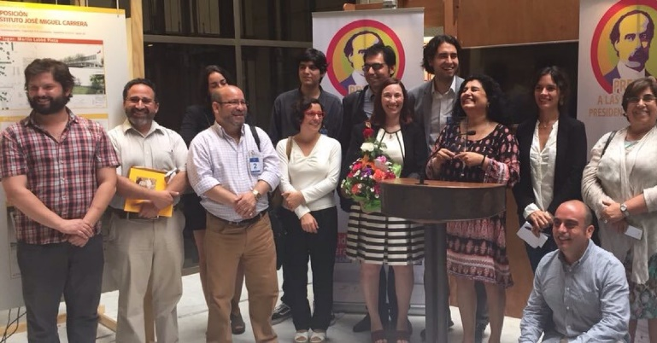
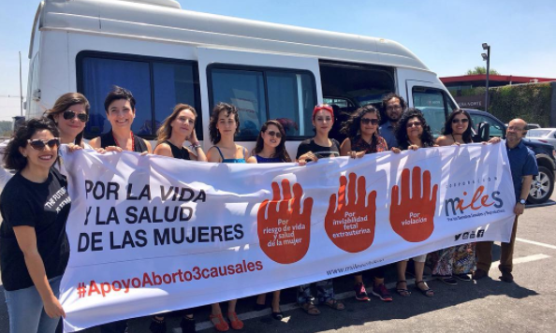
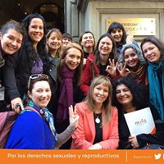
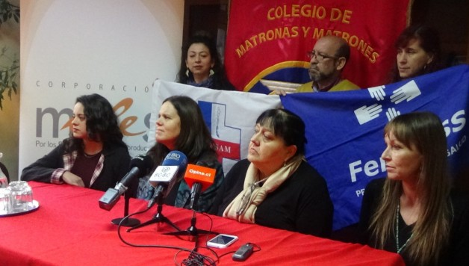
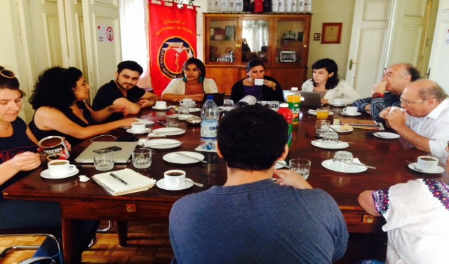
4. Alliances with diverse national and international actors
Colegio de Matronas y Matrones de Chile (National Asssociation of Midwives of Chile)
Federación Nacional de Profesionales de la Salud, FENPRUS (National Association of Health Professionals)
Confederación Unitaria de Trabajadores de la Salud Municipal, CONFUSAM (National Confederation of Municipal Health Workers)
Movimiento de Integración y Liberación Homosexual, MOVILH (Movement of Homosexual Integration and Liberation)
Activist Women
Renowned representatives of culture and the arts
Diverse citizens’ NGOs
Parliamentarians
Polítical parties and movements
Universities
Other international organizations

Slide 10
5. Communication Strategy along 7 years
Alliance with companies: Grey Videos
Videos won 3 Cannes Lion Prizes
Videos won National Publicity Prizes
Claudia Dides received Presidente Balmaceda’s Freedom Prize 2016
Testimonial Videos
Cuenta Conmigo (Count on Me)/Profesionales de la Salud (Health Professionals)
Ellas Deciden Yo Acompaño (They Decide, I Accompany
Videos showing “self-recorded” support testimonies of personalities of the political, cultural, artistic, activist worlds
Permanent communication strategy in the social networks
Public actions of different kind
Periodic public statements
Press conferences
Instant reaction declarations on daily occurrences
Frequent Marches and Rallies

Slide 11
National and International Media Coverage
https://www.youtube.com/watch?v=MYXgbpSbTNg

Slide 12
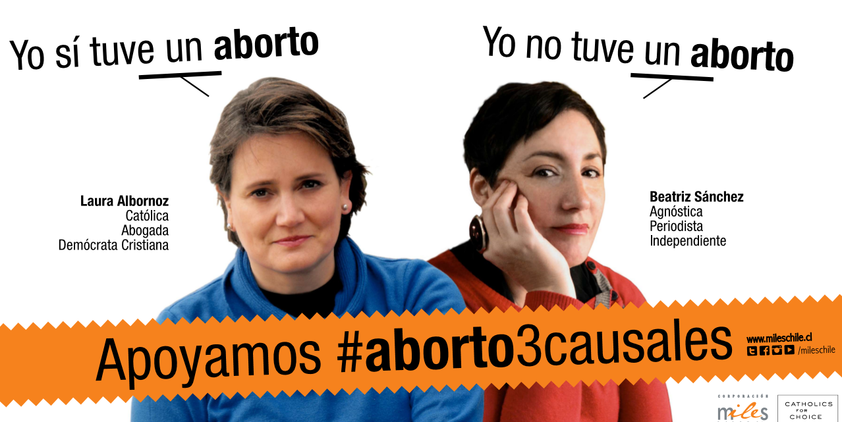
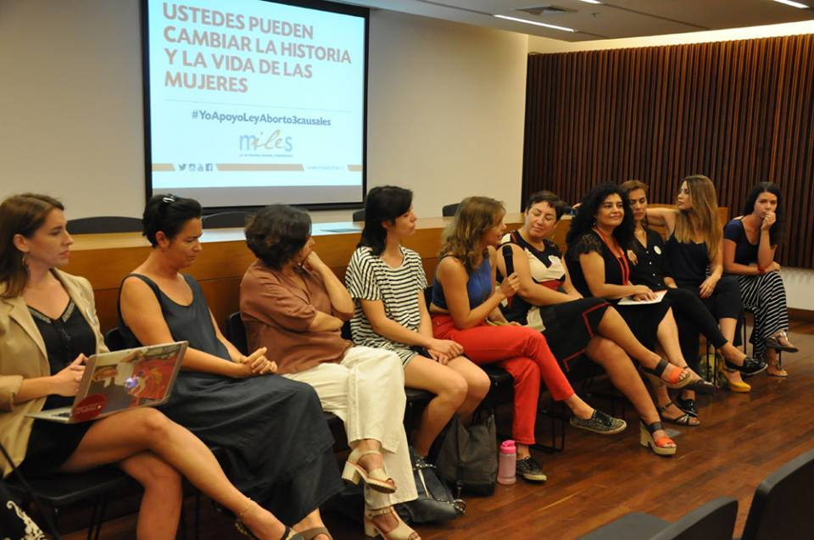
Communication Campaigns

Slide 13
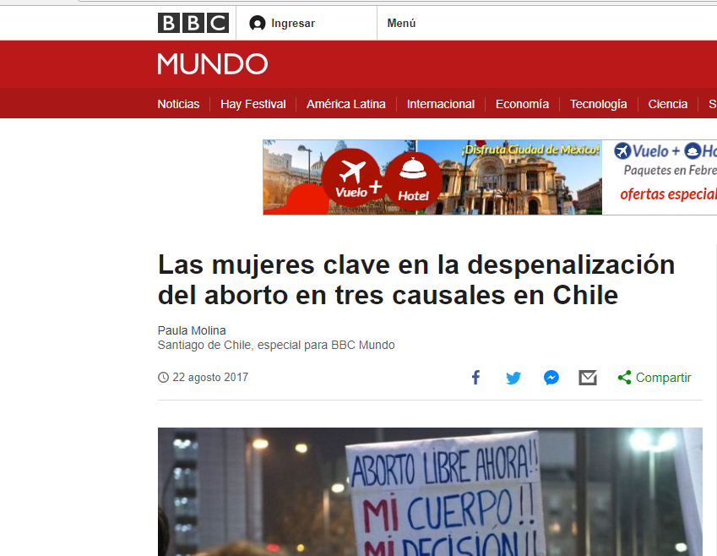
More than 1000 references in national and international media since 2010
Presidente Michelle Bachelet
Ministra Claudia Pascual
Activista Claudia Dides
Diputada Karla Rubilar y Senadora Lily Pérez
http://www.bbc.com/mundo/noticias-america-latina-40998456
Notes:
Constituye un incumplimiento de las obligaciones que el Estado de Chile ha adquirido en materia de derechos humanos de las mujeres.
Convención contra la Tortura y otros tratos o penas crueles, inhumanos o degradantes.
Pacto Internacional de los Derechos Económicos, sociales y culturales.
Convención Belem Do Para.
Convención de los Derechos del Niño.
Comité para la Eliminación de la Discriminación contra la Mujer.
OEA a través del Comitè Expertas del Mecanismo de Seguimiento de la Implementación de la Convención Interamericana para prevenir, sancionar y erradicar la violencia contra la mujer.

Slide 14
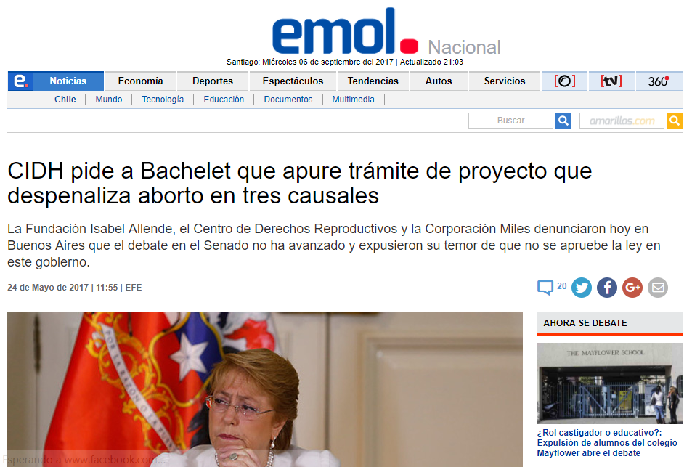
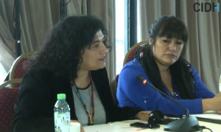
6. Legal Initiatives (case defenses in court, comissions, etc.) Comisión Interamericana (Mayo 2017)
Notes:
Constituye un incumplimiento de las obligaciones que el Estado de Chile ha adquirido en materia de derechos humanos de las mujeres.
Convención contra la Tortura y otros tratos o penas crueles, inhumanos o degradantes.
Pacto Internacional de los Derechos Económicos, sociales y culturales.
Convención Belem Do Para.
Convención de los Derechos del Niño.
Comité para la Eliminación de la Discriminación contra la Mujer.
OEA a través del Comitè Expertas del Mecanismo de Seguimiento de la Implementación de la Convención Interamericana para prevenir, sancionar y erradicar la violencia contra la mujer.

Slide 15
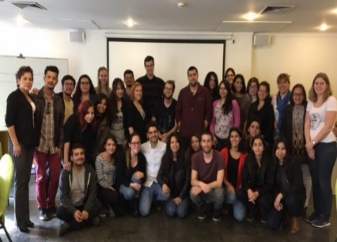
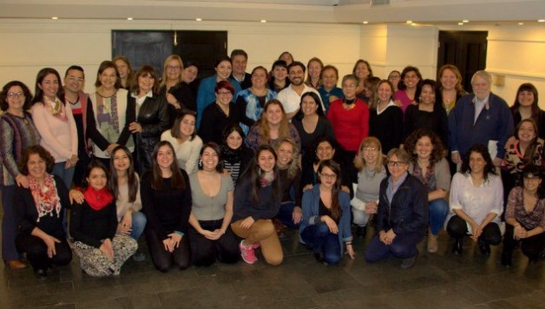
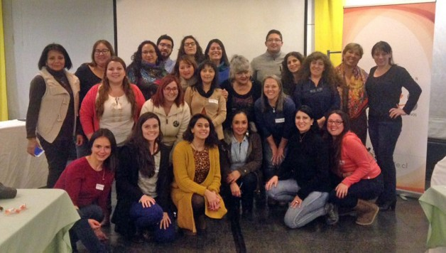
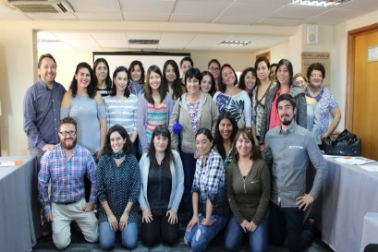
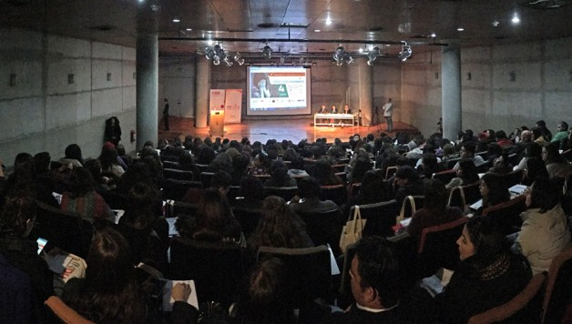
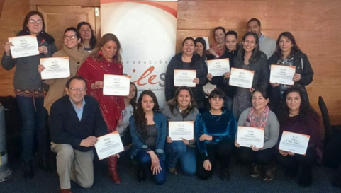
7. Sensibilization, training, formation
Between 2015 and August 2017: More than 700 people have been trained (physicians, midwives, professionals)

Slide 16
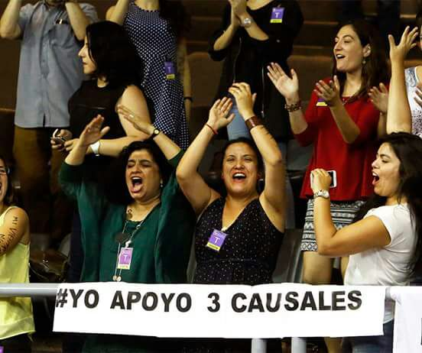
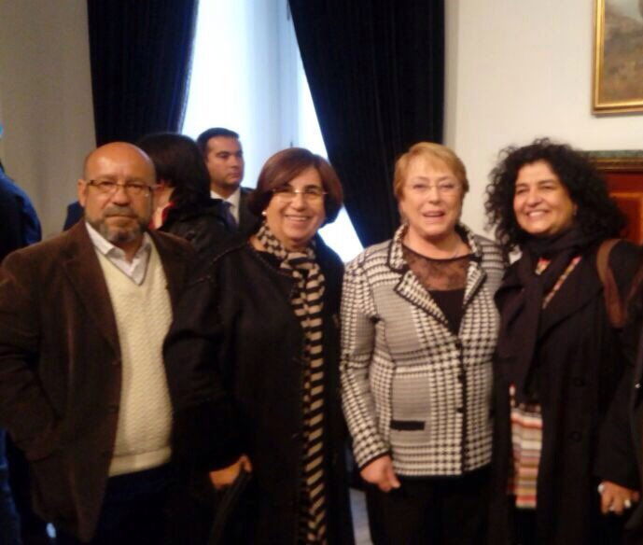
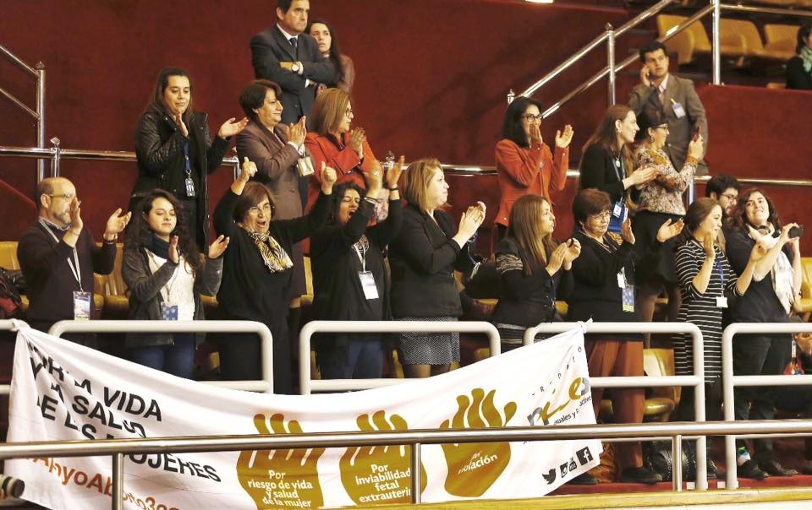
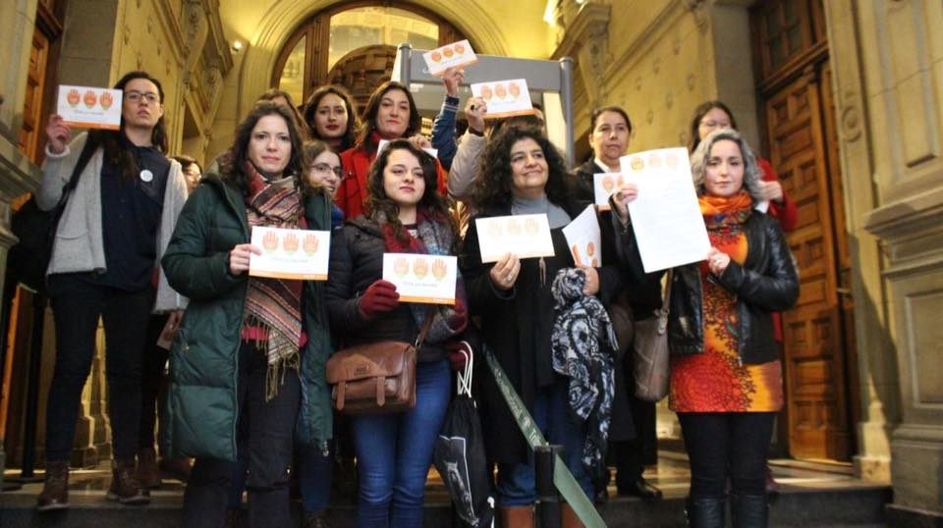
8. Law 21.030: Images of Congress, Constitutional Court and Promulgation of the Law by President Bachelet
Rolando Jiménez (MOVIHL)
M.Antonieta Saa (MILES)
President Michelle Bachelet
Claudia Dides (MILES)

Slide 17
9. Challenges posed by the Law and its Implementation (or Not Everyting is Bright Under the Sun)
“Institutional conscientious objection” for those people intervening in the operation who would have some value or religious restriction to obey it. It applies to public or private institutions providing health services. This is a subterfuge introduced by conservative sectors to avoid obeying the law
Elaboration by the government of the key regulations and complementary norms documents. The precise contents of these documents are crucial to allow for the actual application of the Law. Complete lack of participation of CSOs in the on-going process of Government elaboration of these documents
Accompanying services to be provided to the pregnant woman who wants to interrupt her pregnancy (by any of the 3 causes). Danger: the role of conservative or religious-oriented institutions to try to convince women to avoid abortion, which is not the spirit of the Law on this matter
Training and formation of health services provoiders and multi-discipolinary teams to prepare for the implementation of the Law. This is crucial given the fact that after 27 years of abortion prohibition in the country modern abortion techniques have not been included in the formation of health professionals.
Elaboration by government of list (presidential decree) of institutions allowed to render support and accompanying services to women in situation to abort. Danger of monopolization by conservative organizations which have quite a leverage power vis a vis Government
Difusion of the law among Chilean women and women’s empowerment and organization to demand its application when a case calls for it
Risk of future legislative reforms coming from conservative sectors and the need to avoid its occurrence

Slide 18
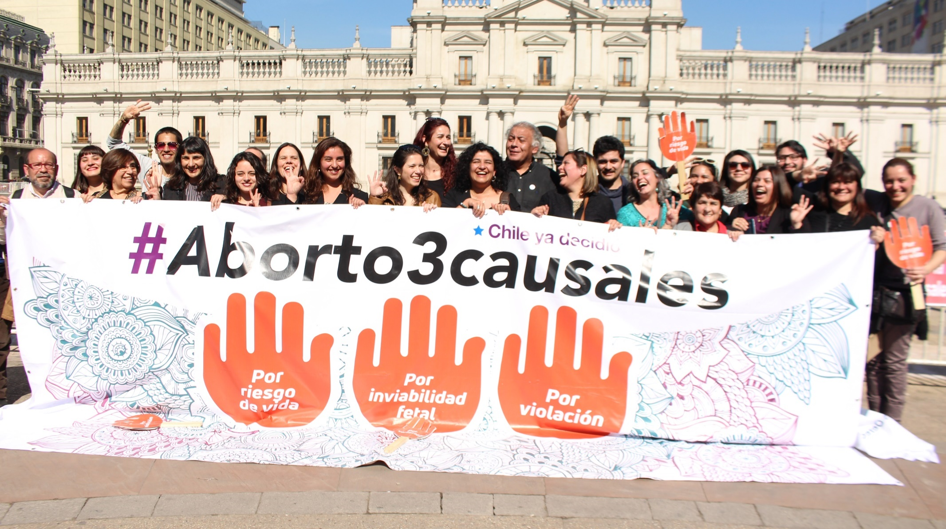
www.mileschile.cl
@mileschile
www.Facebook.com/mileschile
https://www.youtube.com/watch?v=mGEYh7Ajcbc&t=11s

