Slide 1
Situating Abortion Struggles in Latin America: Finding our Feet, Standing our Ground
Inter-American Dialogue
Dec 6, 2017
ALICIA ELY YAMIN, JD MPH
VISITING PROFESSOR OF LAW, GEORGETOWN UNIVERSITY LAW CENTER
PROGRAM DIRECTOR, HEALTH AND HUMAN RIGHTS INITIATIVE
O'NEILL INSTITUTE FOR NATIONAL AND GLOBAL HEALTH LAW
GEORGETOWN UNIVERSITY LAW CENTER
ADJUNCT LECTURER ON LAW AND GLOBAL HEALTH
HARVARD TH CHAN SCHOOL OF PUBLIC HEALTH
PANELIST, UN SECRETARY GENERAL’S INDEPENDENT ACCOUNTABILITY PANEL (EWEC)
GLOBAL FELLOW, CENTRE ON LAW AND SOCIAL TRANSFORMATION

Slide 2
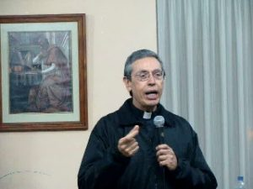
Litigating Health Rights: Can Courts Bring More Justice to Health?
2
Situating Abortion Struggles in Latin America: Finding our Feet, Standing our Ground
Outline
Historical Context
Today’s Political Economy of SRR
Concluding Reflections

Slide 3
Historical Context
Litigating Health Rights: Can Courts Bring More Justice to Health?
3
Situating Abortion Struggles in Latin America: Finding our Feet, Standing our Ground
1990’s UN Conferences
Seeding Norms, Litigating at Supra-National Level
Opening spaces, amplifying voices
Redress for Individuals
Law reform, policy change
Conservatives: backlash, and appropriation of strategies
“Reproductive health was the deal maker or breaker – to achieve approval of the Millennium Declaration at the General Assembly, reproductive health had to be omitted”—David Hulme (“Reproductive Health and the Millennium Development Goals: Politics, Ethics, Evidence and an ‘Unholy Alliance’,” 2009)
BUT two vocabularies, and different organizing principles

Slide 4
Fast Forward….
Litigating Health Rights: Can Courts Bring More Justice to Health?
4
Situating Abortion Struggles in Latin America: Finding our Feet, Standing our Ground
Actors/Institutions
NGOs, States (branches/levels); funders, etc--- especially Transnational advocacy networks “bound together by shared values, a common discourse, and a dense exchange of information and services.” Keck and Sikkink (1999).
Opportunities Structures for Mobilization
(e.g., political, legal/judicial, supra-national, social)

Slide 5
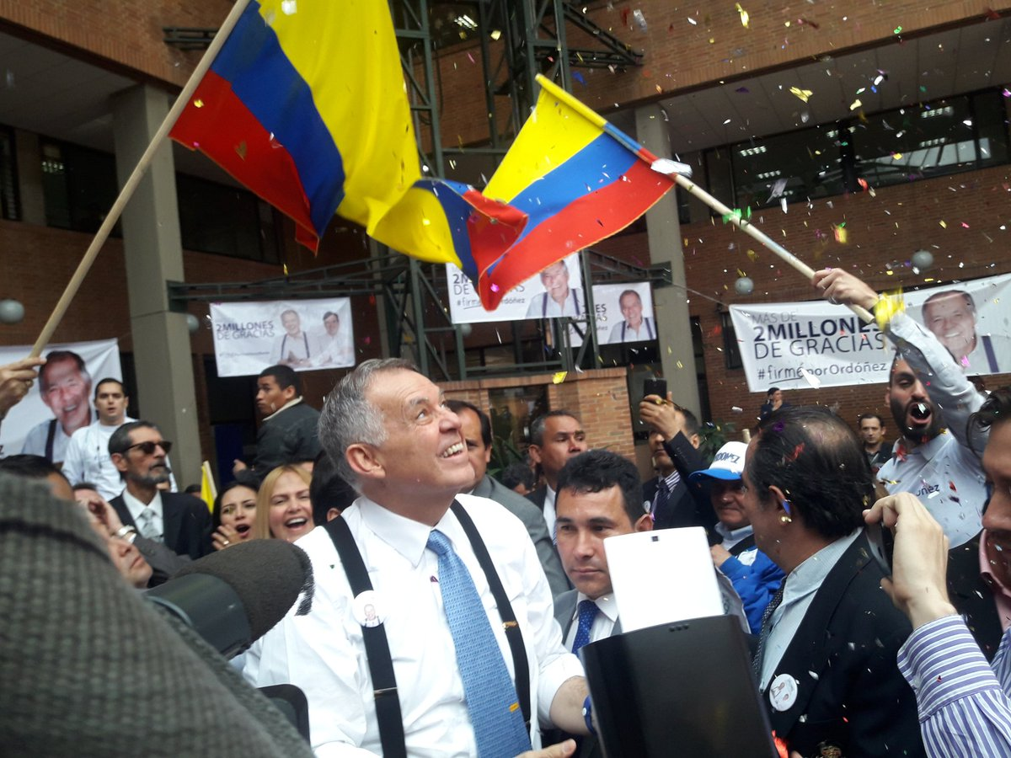
Litigating Health Rights: Can Courts Bring More Justice to Health?
5
Situating Abortion Struggles in Latin America: Finding our Feet, Standing our Ground
Political Economy of SRR Today
Ascendancy of Conservative populism
Combating ‘gender ideology’
(e.g. Colombia, Paraguay)
‘Natural order’ and confessional education (e.g., Brazil)

Slide 6
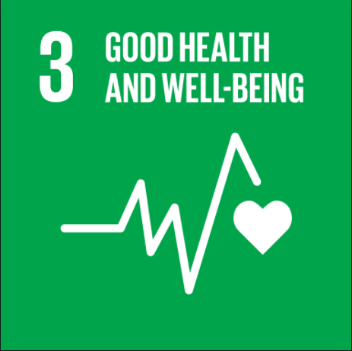
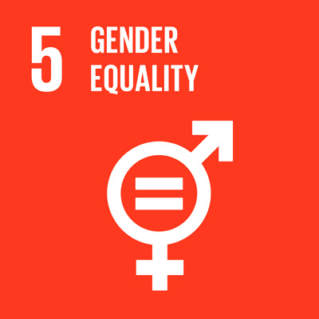
Litigating Health Rights: Can Courts Bring More Justice to Health?
6
Situating Abortion Struggles in Latin America: Finding our Feet, Standing our Ground
Political Economy of SRR Today
(2) From MDGs to SDGs: New opportunities, new challenges
Target
3.1 By 2030, reduce the global maternal mortality ratio to less than 70 per 100,000 live births
3.7 By 2030, ensure universal access to sexual and reproductive health-care services, including for family planning, information and education, and the integration of reproductive health into national strategies and programs
3.8 Achieve universal health coverage, including financial risk protection, access to quality essential health-care services and access to safe, effective, quality and affordable essential medicines and vaccines for all
5.6 Ensure universal access to sexual and reproductive health and reproductive rights as agreed in accordance with the Program of Action of the International Conference on Population and Development and the Beijing Platform for Action and the outcome documents of their review conferences
16.3 Promote the rule of law at the national and international levels and ensure equal access to justice for all

Slide 7
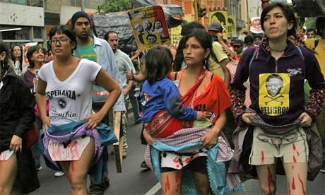
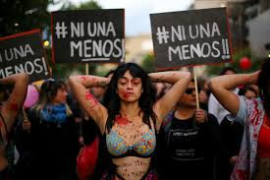
7
Situating Abortion Struggles in Latin America: Finding our Feet, Standing our Ground
Concluding Reflections

